Slide 1
Unit 5 Vocabulary
Pythagorean Theorem

Slide 2
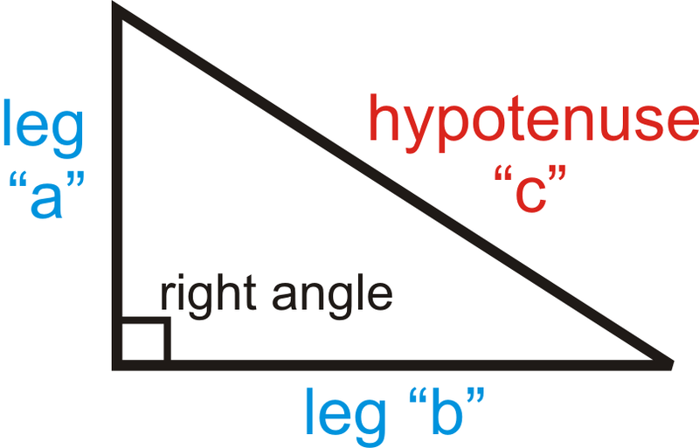
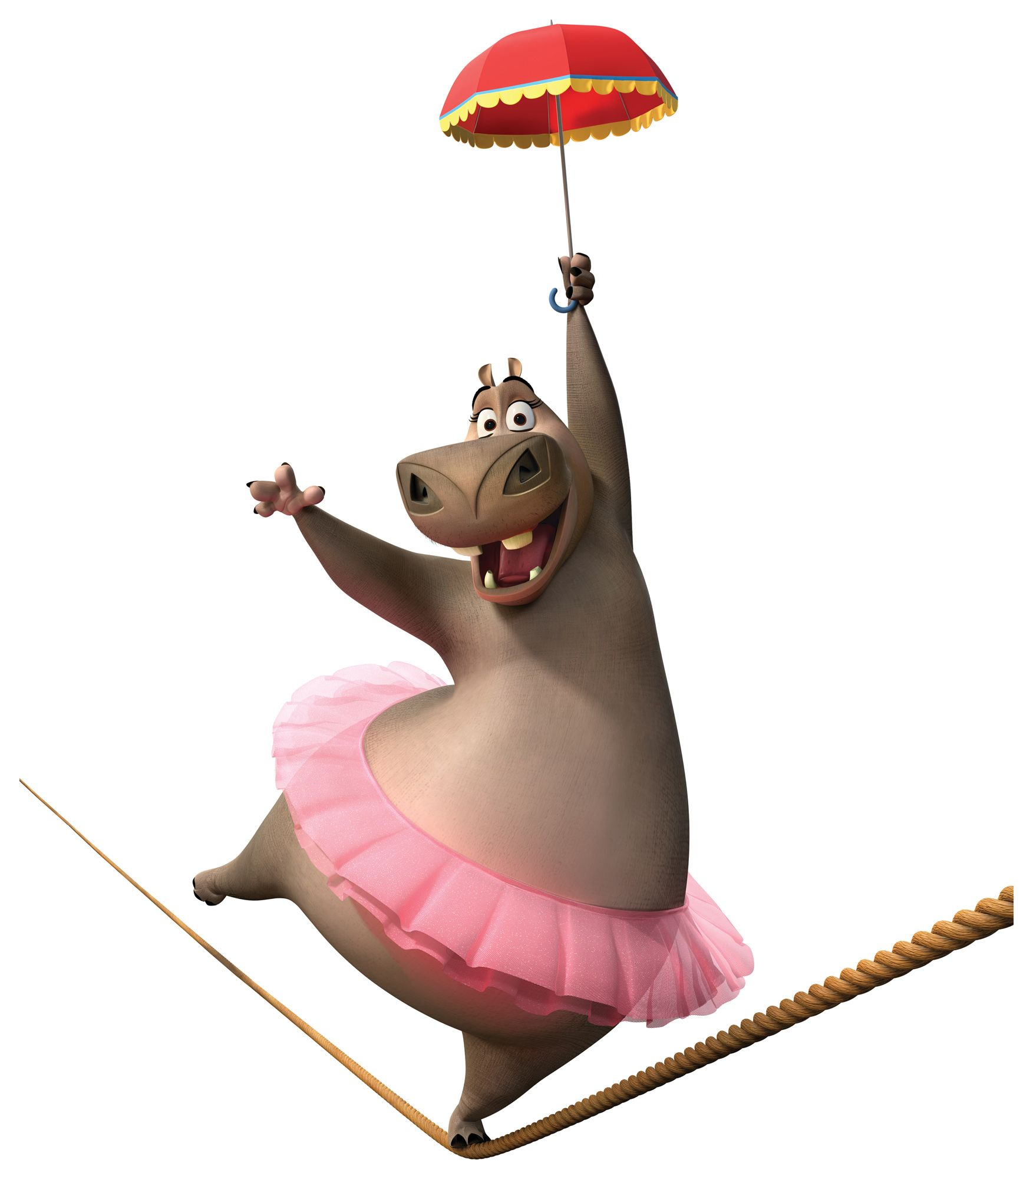
Right Triangle
90 degree

Slide 3
Pythagorean theorem
Find the hypotenuse
Find the leg

Slide 4
Pythagorean Triple. Label
15
10
9
5
6
3
4
8
12

