Slide 1
Real Number Review
BE RESPECTFUL, BE RESPONSIBLE, BE ENGGAGED

Slide 2
Notes:
LiveSlide http://www.math-play.com/Comparing-Rational-Numbers/comparing-rational-numbers-jeopardy-game.html

Slide 3
Mustang check
Comparing Numbers Jeopardy: score=

Slide 4
Notes:
LiveSlide https://www.quia.com/pop/37541.html?AP_rand=605196122

Slide 5
Mustang check
Self-check drop down: score=

Slide 6
Notes:
LiveSlide http://www.math-play.com/rational-and-irrational-numbers-game/rational-and-irrational-numbers-game.html

Slide 7
Mustang check
Rational and Irrational card sort: score=

Slide 8
Notes:
LiveSlide http://staff.argyll.epsb.ca/jreed/math9/strand1/munchers.htm

Slide 9
Mustang check
Number system muncher: complete= yes no

Slide 10
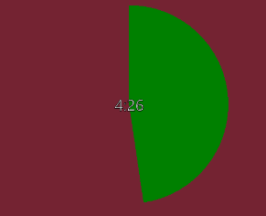
Clear Target
I can: apply prior knowledge
So that I can: classify, compare, and contrast real numbers
My goal is:
800 + on jeopardy
16+ on self-check DD

