Slide 1
Unit 3
Vocabulary

Slide 2
Coordinate Plane
Used to locate a point
Ordered Pairs

Slide 3
Table
X | Y
Used to organize data

Slide 4
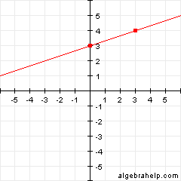
Graph

Slide 5
X-AXIS
_______________________________________________
Horizontal

Slide 6
Y-AXIS
|
Vertical

Slide 7
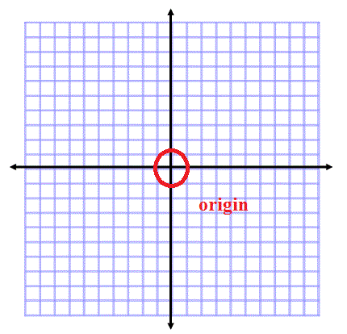
Origin

Slide 8
Constant
The same
Not changing

Slide 9
Rate of change
Slope
M
Change in Y ----------------- Change in X
Rise ____________ Run

