Slide 1
Unit 4 Vocabulary
8th grade Math 2nd period

Slide 2
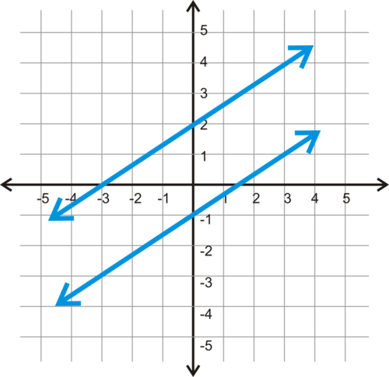
No Solution
No Touchy!!!
Parallel

Slide 3
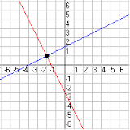
1 Solution
1 Touchy!
Intersecting -Cross

Slide 4
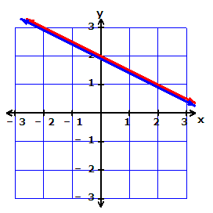
Infinite Solution
Unlimited
Same line

Slide 5
Solution
Ordered pair where the lines touch
(x,y)

Slide 6
Elimination
Get rid of!

Slide 7
Substitution
Replace or Switch

Slide 8
Slope Intercept
Y=mx+b

Slide 9
Standard Form
AX+BY=C

